Slide 1

Problems on Relational Algebra
Dr. Sanjeev Kumar
Asst. Professor

Slide 2
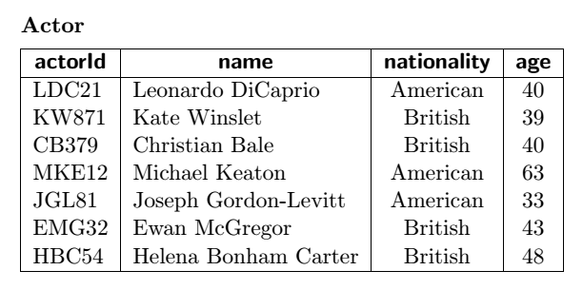
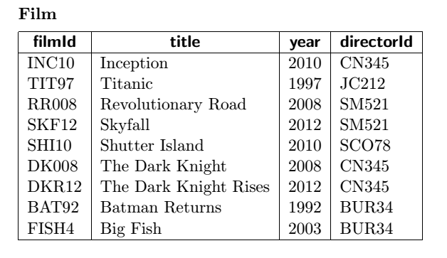
A Relational Mo del for Films .The following DDL declarations and table data describe a relational mo del for the film industry.

Slide 3
